Slide 1
Optical communications and data networks (EENGM2001) Week14_Lecture012_ASync_electronicAmplifiers
Siddarth K Joshi

Slide 2
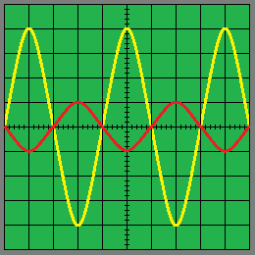
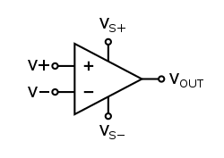
Amp
Signal from photodiode is weak (~pA or nA)
We use amplifiers to get a stronger signal
Simplest: Op-Amp

Slide 3
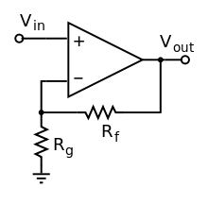

Op-Amp
Can have very high gain ( 1E5 or so)
$$Vout=Vin (1+\frac{Rf}{Rg})$$

Slide 4
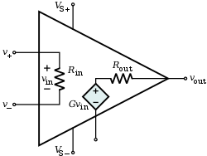
Op-Amp
V. High input impedance R_{in}, and so low input current
V. Low output impedance R_{out}, and so large output current range
Isolate input and output (Nothing flows backwards)

Slide 5
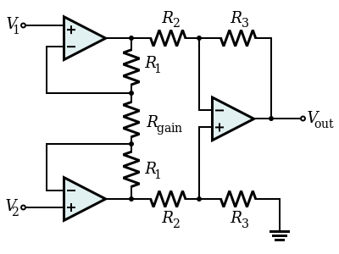
Instrumentation Amp
First stage is low gain
Great for impedance matching any photodetector.
Is differential input:
Only modulated light affects the amplifiers.
V. Low noise, High speed.

Slide 6
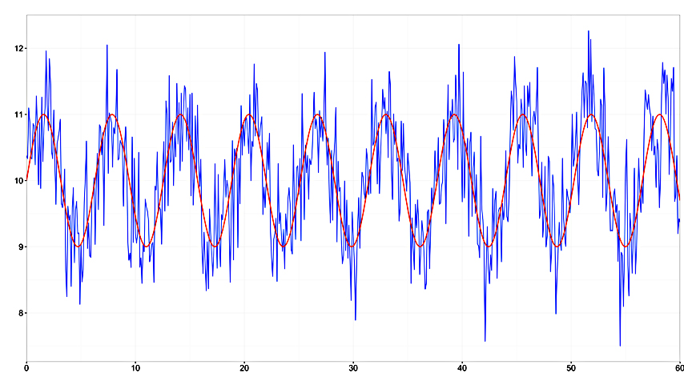
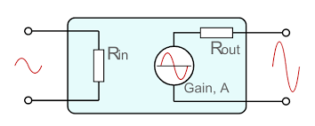
Using amplifiers
Amp does not change signal to noise
Both get amplified equally
You can only use filters to reduce signal and noise at specific frequency ranges

